Slide 1
18ECO133T - SENSORS AND TRANSDUCERS
PREPARED BY : Mrs.G.Annapoorani
A.P (Sr. G)/ ECE
SRMIST

Slide 2
18ECO133T - SENSORS AND TRANSDUCERS
UNIT 1
Introduction to sensors/ transducers, principles, classification based on different criteria,
Characteristics of measurement systems, Static characteristics - Accuracy, Precision, Resolution, Sensitivity,
Dynamic characteristics and Environmental Parameters,
Characterization and its type - Electrical characterization,
Mechanical Characterization, Thermal Characterization,
Optical Characterization, Errors and its classification,
Selection of transducers, Introduction to mechanical sensors
Resistive potentiometer and types, Strain gauge: Theory, type, design consideration, sensitivity.
Resistive transducer: RTD, materials used in RTD, Thermistor: thermistor material, shape.

Slide 3
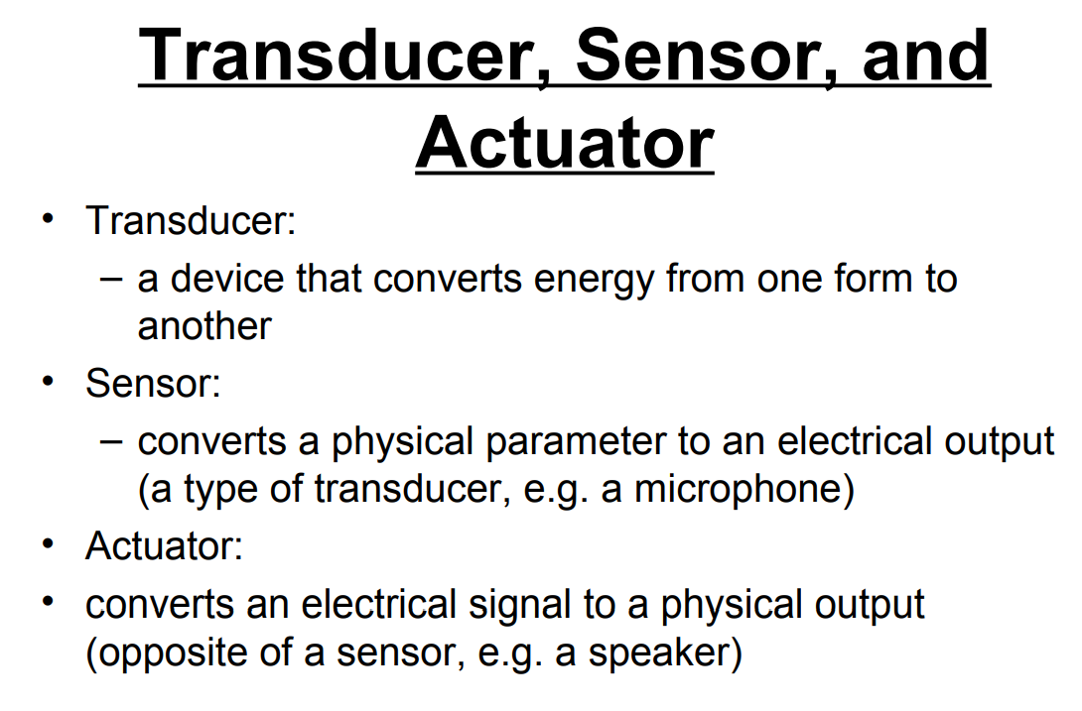

Slide 4
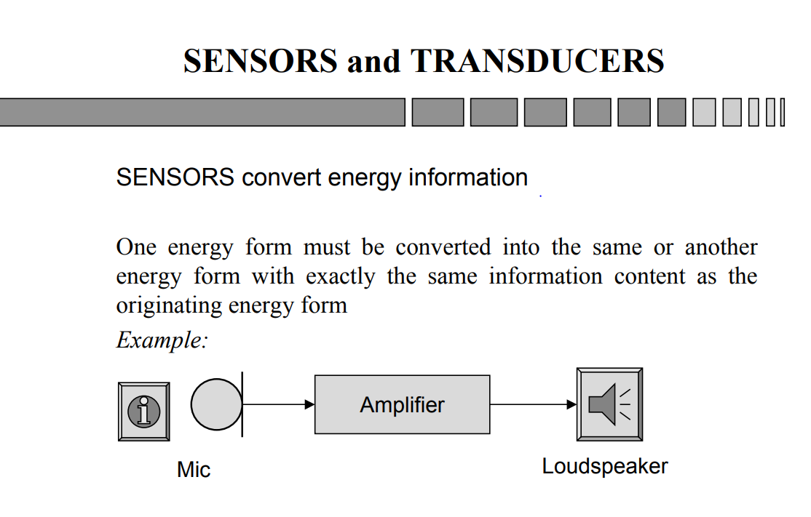

Slide 5
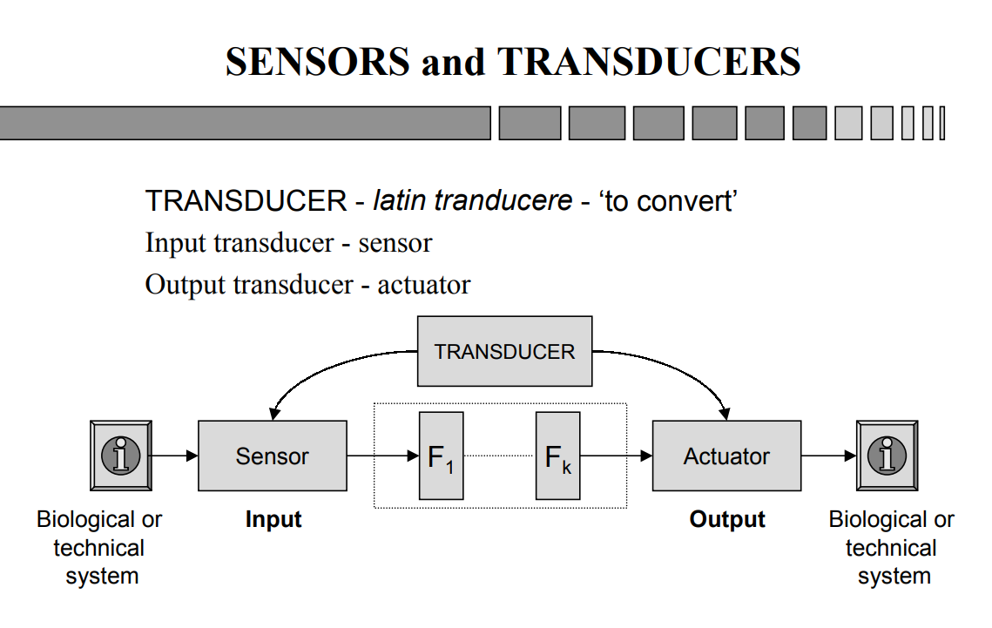

Slide 6
SESSION 1
Introduction to sensors/ transducers
Principles
Classification based on different criteria
BASED ON TRANSDUCTON PRINCIPLES
TECHNOLOGY BASED CLASSIFICATION
APPLICATION BASED CLASSIFICATION
PROPERTY BASED CLASSIFICATION
BASED ON EMERGING SENSOR TECHNOLOGIES

Slide 7
What are Sensors /Transducers
Definition from Instrument Society of America
A sensor or transducer as a device which provides a usable output in response to a specified measurand.
Output is defined as an 'electrical quantity' and
Measurand -Physical quantity, or condition which is measured.’
Physical quantity :Temperature, Pressure, force, motion, displacement, humidity, light flow etc.
Electrical quantity: Change in resistance, inductance, capacitance etc.
Generalized Definition is extending 'electrical quantity' to any type of signal such as mechanical and optical and extending 'physical quantity, property, or condition being measured' to those of nature--chemical and biochemical and so on.

Slide 8
PRINCIPLES
Sensor As an element that senses a variation in input energy to produce a variation in another or same form of energy is called a sensor.
Transducer uses transduction principle to convert a specified measurand into usable output.
Thus, a properly cut piezoelectric crystal can be called a sensor whereas it becomes a transducer with appropriate electrodes and input/output mechanisms attached to it.
The principles can be grouped according to the form of energy in which the signals are received and generated.

Slide 9
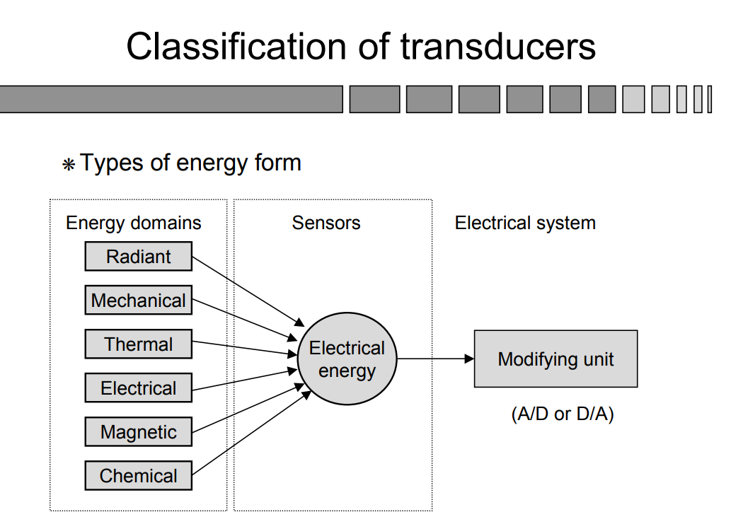

Slide 10
ENERGY TYPES AND CORRESPONDING MEASURANDS
Mechanical :Length, area, volume, force, pressure, acceleration, torque, mass flow, acoustic intensity, and so on ..
Thermal :Temperature, heat flow, entropy, state of matter.
Electrical :Charge, current, voltage, resistance, inductance, capacitance, dielectric constant, polarization, frequency, electric field, dipole moment, and so on.
Magnetic :Field intensity, flux density, permeability, magnetic moment, and so forth.
Radiant :Intensity, phase, refractive index, reflectance, transmittance, absorbance, wavelength, polarization, and so on.
Chemical :Concentration, composition, oxidation/reduction potential, reaction rate, pH, and the like.

Slide 11
CLASSIFICATION
It is very difficult to classify sensors under one criterion and hence, different criteria may be adopted for the purpose.
Some of these include:
1.Transduction principles using physical or chemical effects,
2.Primary input quantity - Measurand,
3.Material and technology,
4.Application
5.Property.

Slide 12
Subclassification
Another very preliminary classification or subclassification as it may be, is based on the energy or power supply requirements of the sensors.
This means that some sensors require power supply and there are some that do not.
As a result, the sensors are called active and passive respectively. Sometimes, terms such as self-generating and modulating are used to qualify these.

Slide 13
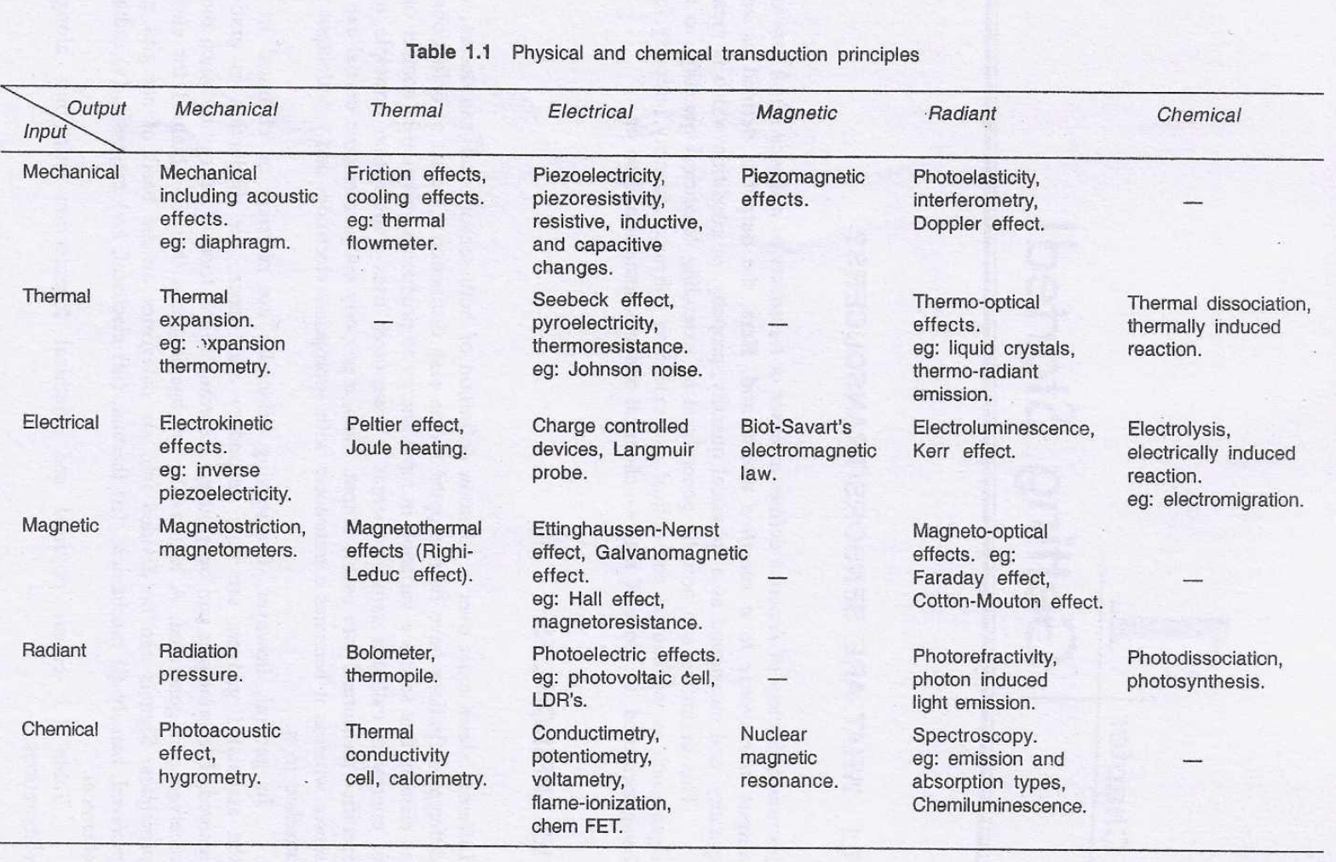
TABLE 1. 1 ENLISTS PHYSICAL AND CHEMICAL TRANSDUCTION PRINCIPLES ALONG WITH SOME ELABORATIONS.

Slide 14
TECHNOLOGY BASED CLASSIFICATION
Conventional sensors are now aptly supported by technologies which have yielded Micro Electro Mechanical Sensors (MEMS), CMOS image sensors, displacement and motion detectors and biosensors.
Similarly, Coriolis, magnetic and ultrasonic flowmeters, photoelectric, proximity, Hall effect, infrared, integrated circuit (IC), temperature, radar-based level sensors are also relatively modern.

Slide 15
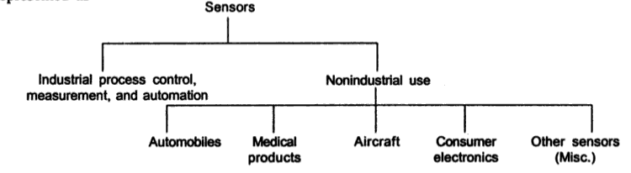
APPLICATION BASED CLASSIFICATION

Slide 16
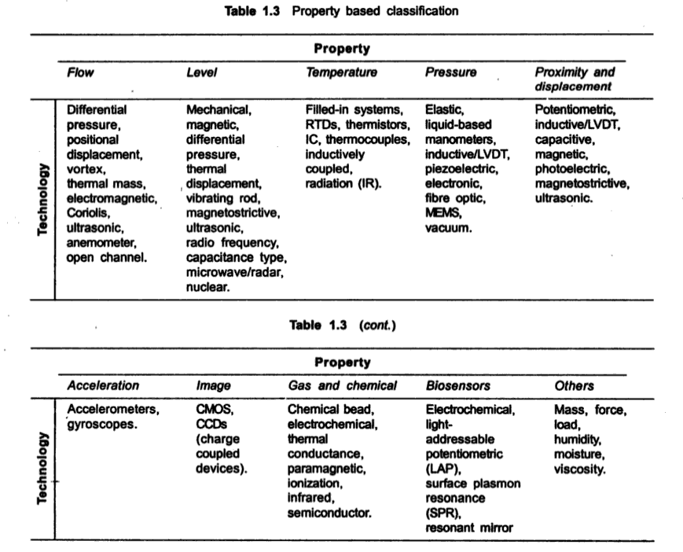
PROPERTY BASED CLASSIFICATION

Slide 17
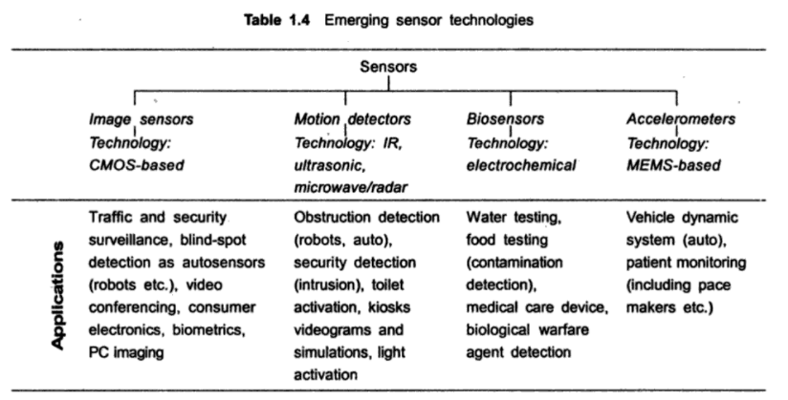
Table 1.4 shows the emerging sensor technologies with current and future application schedules as a chart.

Slide 18
SESSION 2
CHARACTERISTICS OF MEASUREMENT SYSTEMS
Static characteristics
Accuracy
Precision
Resolution and
Sensitivity

Slide 19
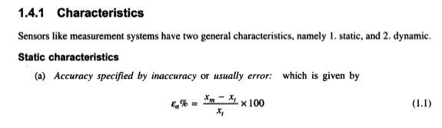
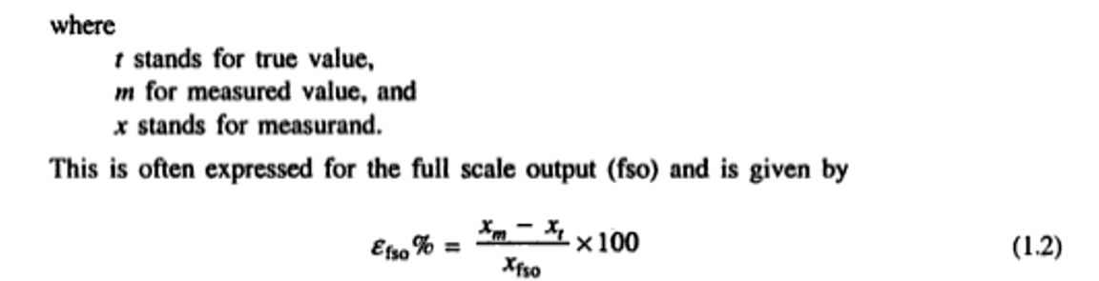
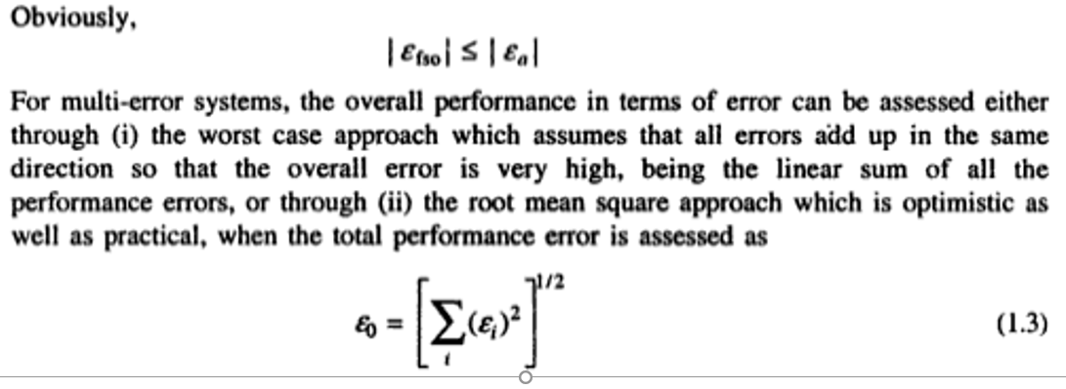

Slide 20
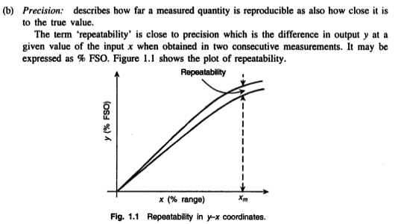

Slide 21
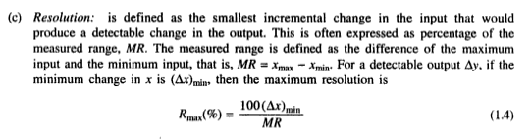
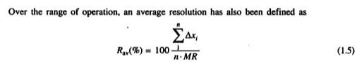

Slide 22
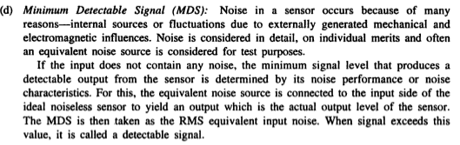
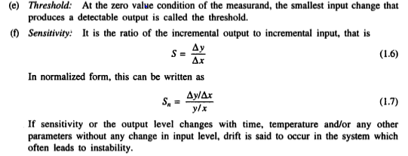

Slide 23
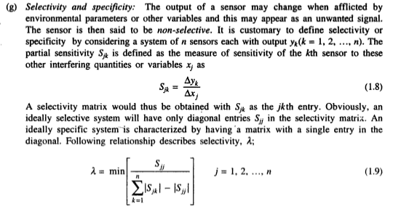

Slide 24
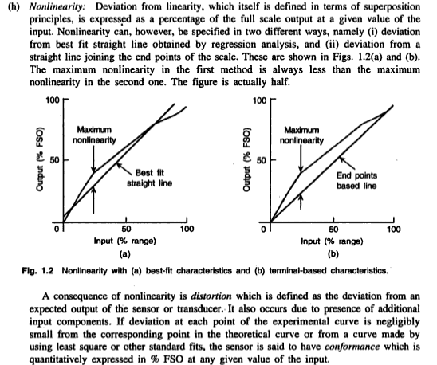

Slide 25
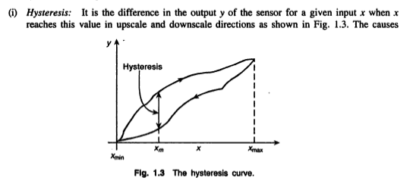
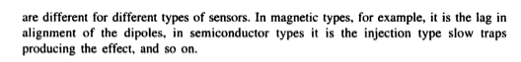
It can be defined as the maximum difference in the output values obtained by covering the measurand range first in the increasing direction (i.e. from zero to 100%) and then in the decreasing direction (i.e. from 100% to zero).

Slide 26
SESSION 3
CHARACTERISTICS OF MEASUREMENT SYSTEMS
Dynamic characteristics
ENVIRONMENTAL PARAMETERS

Slide 27
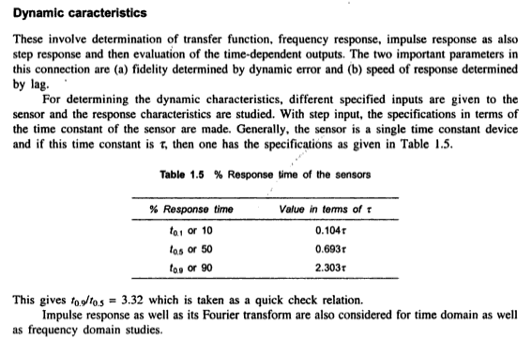

Slide 28
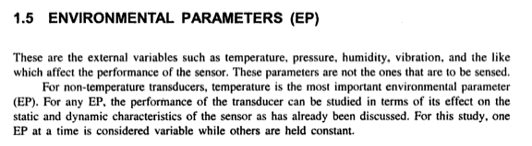

Slide 29
SESSION 4, 5, 6
SESSION 4: Characterization and its type - Electrical characterization,
SESSION 5: Mechanical Characterization and Thermal Characterization
SESSION 6: 1. Optical Characterization.
2. Errors and its classification,

Slide 30
CHARACTERIZATION
Characterization of the sensors can be done in many ways depending on the types of sensors. specifically microsensors These are
Electrical,
Mechanical,
Optical,
Thermal,
Chemical,
Biological and so on.
ELECTRICAL CHARACTERIZATION
It consists of evaluation of electrical parameters
IMPEDANCES, VOLTAGE AND CURRENTS
The Knowledge of sensor “output impedance” is important for coupling measuring instruments.
For voltage sensitive sensors, the ratio of the input impedance of the measuring equipment to the output of the transducer/sensor should be very high, for current sensitive sensors. reverse is true.

Slide 31
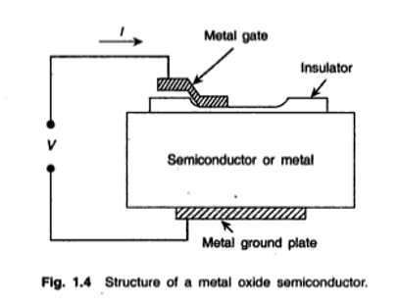
2. BREAKDOWN VOLTAGES AND FIELDS
'Breakdown' of the insulating parts of the sensor is very critical as the health of the system depends on it.
For Metal – Insulator – Metal (MIM) or for Metal – Insulator -Semiconductor (MIS) Structures, the breakdown of the insulating film is studied by the system.
of Fig. 4
Three different types of breakdown are
Dielectric strength.
wear out and
Current induced breakdown.

Slide 32
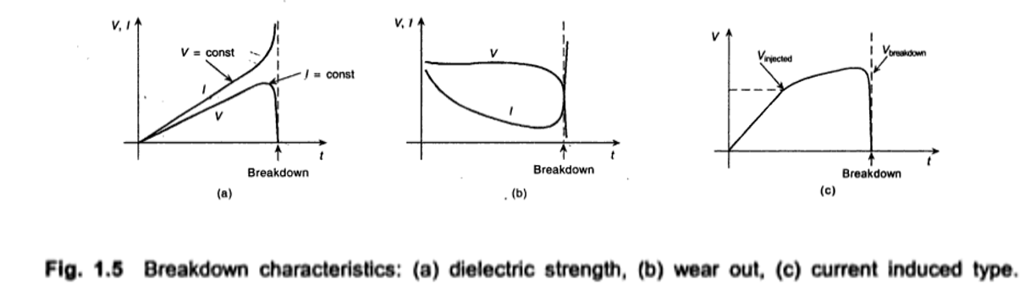
Breakdown generally implies a sudden or 'avalanche' change in the voltage or current­ dropping to a negligible value and current rising to a very high value.
Breakdown may be extrinsic or intrinsic though the mechanism in either case is basically the same.
There occurs a high local field in the material which may be defect-induced which then is called extrinsic.
However. if this is high field induced microvoids is called intrinsic type.
In the latter case, the high field induces microvoids to generate defects leading it to behave as the extrinsic type.

Slide 33
3. LEAKAGE CURRENT
Leakage current measurement specifies the sensor quality, specifically its insulating quality as also the quality of p-n junctions wherever it exists.
4. NOISE
It comes from electromagnetic interference. AC magnetic fluctuation, 50Hz supply pick up. mechanical or acoustical vibration, or photon induced output.
Sensors are to be characterized for noise testing for immunity to such noise. For testing purposes, different noise sources are developed.
5. CROSSTALK
In multichannel or array sensors “crosstalk” may occur due be overlapping of signals between the two adjacent transducer elements.
It may however occur in a single transducer system because of inductive or capacitive coupling or coupling through the common voltage source during transduction inside the element. It is done using correlation techniques.

Slide 34
MECHANICAL AND THERMAL CHARACTERISATION
It involves mechanical and thermal properties related to the overall reliability and integrity of the transducer. as well as relevant transduction process.
Reliability is an important aspect of characterization. By means of testing, the functional and reliable portion of a batch of sensors or transducers is identified.
Basically, failure analysis is performed and the mechanism of failure is attempted to be eliminated and thereby reduce the subsequent failures.
In fact, the above two approaches are supplementary to each other.
Failure of transducers can be divided into three different categories.
(i) Catastrophic early life failures. often called infant mortality.
(ii) Short term drifts in sensor parameters and
(iii) Long term drifts and failures.
Catastrophic failure of the sensors is the complete failure in the normal operation. It is called wear out if it occurs in later life.
Short term and Long term drifts are, in effect, changes in sensor parameters and are, therefore to be studied more intensely for the sensor characterization.

Slide 35
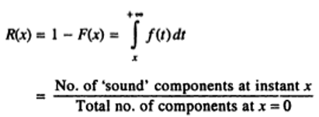
The Reliability of an item is given by what is known as reliability function R(x) which is the probability that the item would survive for stated interval, say between 0 and x.
If F(x) is the probability of failure. then
The probability of failure F(x) is actually a cumulative distribution function and in reliability statistics, the distribution functions that are used may have the following characteristics. (i) Normal
(ii) Exponential
(iii) Log – Normal
(iv) Gamma and
(V) Weibull.
In general, the failure has a time dependency as shown in Fig 1.6. The curve between failure rate and time appears like a bath tub which can be divided into three distinct zones
Zone 1 is the infant mortality zone.
Zone 2 is the working zone with constant failure rate.
Zone 3 is the wear out zone.

Slide 36
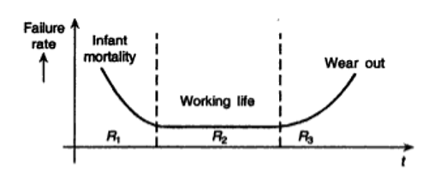
As the normal working life is usually very long, Estimating failure is tested by ‘Accelerated ageing test’.
Before this ageing test, screening steps are taken to isolate the defective transducers. These steps vary depending on the types of the transducers. For Standard Integrated Type Sensors (SITS), the typical tests that are performed are briefly discussed.
High Temperature Burn In:
The sensors are subjected to a high temperature over a stipulated period, Usually 125 degree Celsius for 48 hours for SITS, when the defective units are burnt out and the remaining ones are expected to run for the expected life.

Slide 37
b. High temperature storage bake:
The units are baked at a high temperature, usually at 250 degree Celsius for SITS, for several hours, when the Instability mechanisms such as contamination, bulk defects, and metallization problems are enhanced in some units which were initially defective. These units are then screened out
c. Electrical overstress test:
Where progressively larger voltages up to 50% in excess of specification are applied over different intervals of time so that failures due to insulation. interconnection or oxide formation can occur in some units which were originally defective and screened out.
d. Thermal shock test:
Mainly done for packaging defects, where the units are subjected to a temperature between 65 degree and 125 degree Celsius for about 10 seconds for every temperature. The time is gradually increased to 10 minutes and the cycle is repeated 10 times. The failed units are rejected.
e. Mechanical shock test:
Also for packaging, this lest is performed by dropping the units from a specified height that varies from 3 to 10 m. Alternately. the unit as shaken by attaching it to a shaking table for a specified period of time.

Slide 38
As has already been mentioned,
Real time operational test for reliability is difficult to perform so that accelerated ageing test has been proposed. The test should simulate the real ageing peace in a much shorter time. High stress is imposed on the sensors and results from such test are used to predict the performance in the normally stressed condition.
The results should be interpreted for
(i) True accelerated ageing.
(ii) Valid extrapolation to obtain expected performance under normal conditions.
(iii) Determining the acceleration factor for the scaling.
that is how many hours of normal operation correspond to 1 hour of accelerated operation.
Appropriate models have been developed for the purpose and failures with respect to specified parameters such as leakage current. Temperature, and so forth are predicted.
OPTICAL CHARACTERIZATION:
It a usually done by ascertaining absorption coefficient, refractive index, reflectivity and the like. Here, again the consideration of the individual merit comes in.

Slide 39
No Measurement is Accurate!
ERRORS AND ITS CLASSIFICATION
Errors occur because of:
Parallax error (incorrectly sighting the measurement).
Calibration error (if the scale is not accurately drawn).
Zero error (if the device doesn’t have a zero or isn’t correctly set to zero).
Damage (if the device is damaged or faulty).
Limit of reading of the measurement device (the measurement can only be as accurate as the smallest unit of measurement of the device).

Slide 40
Types of Errors
Basically Three types of errors are studied:-
Gross Errors
Systematic Errors
Random Errors

Slide 41
Gross Errors
Gross Errors mainly covers the human mistakes in reading instruments and recording and calculating measurement results.
Example:- Due to oversight, The read of Temperature as 31.5 ̊. while the actual reading may be 21.5 ̊. .
Gross Errors may be of any amount and then their mathematical analysis is impossible. Then these are avoided by adopting two means:-
Great care is must in reading and recording the data.
Two , Three or even more reading should be taken for the quantity under measurement.

Slide 42
Systematic Errors
Systematic Errors classified into three categories :-
Instrumental Errors
Environmental Errors
Observational Errors

Slide 43
Instrumental Errors
These errors arises due to three main reasons.
Due to inherent shortcoming in the instrument.
Example:- If the spring used in permanent magnet instrument has become weak then instrument will always read high. Errors may caused because of friction , hysteresis , or even gear backlash.
Due to misuse of the instruments.
Due to Loading effects of instruments.

Slide 44
Environmental Errors
These errors are due to conditions external to the measuring Device including conditions in the are surrounding the instrument.
These may be effects of Temperature, Pressure, Humidity, Dust, Vibrations or of external magnetic or electrostatic fields.

Slide 45
Observational Errors
There are many sources of observational errors:-
-- Parallax, i.e. Apparent displacement when the line of vision is not normal to the scale.
-- Inaccurate estimate of average reading.
-- Wrong scale reading and wrong recording the data.
-- Incorrect conversion of units between consecutive reading.

Slide 46
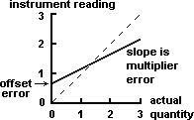
Here in Graph, Full Line shows the systematic Error in non Linear Instrument.
While Broken Line shows response of an ideal instrument without Error.

Slide 47
Random Errors
The quantity being measured is affected by many happenings in the universe. The errors caused by happening or disturbances about which we are unaware are Random Errors. Its also known as residual Errors.

Slide 48
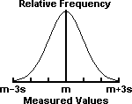
Example of Random Error
The Gaussian normal distribution. m = mean of measurements. s = standard deviation of measurements. 68% of the measurements lie in the interval m - s < x < m + s; 95% lie within m - 2s < x < m + 2s; and 99.7% lie within m - 3s < x < m + 3s.

Slide 49
SESSION 7
SELECTION OF TRANSDUCERS
INTRODUCTION TO MECHANICAL SENSORS

Slide 50
Selection of transducers
There are many ways for measurement of a physical quantity. While selection of transducers, how to select a transducer for a particular application, following points should be kept in the mind.
Unfortunately most transducers are not sensitive to just one quantity.
If measurements are to be made under conditions where there is likelihood of two or more input quantities influencing the transducer, it is desirable to select a transducer which is sensitive to the desirable quantity and insensitive to the unwanted quantity.
If this is not possible, ways and means should be found to eliminate or compensate for the effects of the unwanted input quantity.

Slide 51
Selection of transducers
Operating Principle.
Sensitivity.
Operating Range.
Accuracy
Cross sensitivity
Transient and Frequency Response.
Loading Effects.
Environmental Compatibility
Usage and Ruggedness
Electrical aspects.
Stability and Reliability

Slide 52
Selection of transducers
Operating Principle
The transducers are many times selected on the basis of operating principle used by them. The operating principles used may be resistive, inductive, capacitive, optoelectronic, piezoelectric etc.
Sensitivity.
The transducer must be sensitive enough to produce detectable output.
Operating Range.
The transducer should maintain the range requirements and have a good resolution over its entire range. The rating of the transducer should be sufficient so that it does not breakdown while working in its specified operating range.
Accuracy
High degree of accuracy is assured if the transducer does not require frequent calibration and has a small value for repeatability. It may be emphasized that in most industrial applications, repeatability is of considerably more importance than absolute accuracy.

Slide 53
Selection of transducers
Cross sensitivity
Cross sensitivity is a further factor to be taken into account when measuring mechanical quantities.
There are situations where the actual quantity is being measured is in one plane and the transducer is subjected to variations in another plane.
More than one promising transducer design has had to be abandoned because the sensitivity to variations of the measured quantity in a plane perpendicular to the required plane has been such as to give completely erroneous results when the transducer has been used in practice.
Transient and Frequency Response
The transducer should meet the desired time domain specifications like peak overshoot, rise time, settling time and small dynamic error.
It should ideally have a flat frequency response curve. In practice, however, there will be cutoff frequencies and higher cut off frequency should be high in order to have a wide bandwidth.

Slide 54
Selection of transducers
Loading Effects.
The transducer should have a high input impedance and a low output impedance to avoid loading effects.
Environmental Compatibility
It should be assured that the transducer selected to work under specified environmental conditions maintains its input-output relationship and does not break down.
For example, the transducer should remain operable under its temperature range.
It should be able to work in corrosive environments (if the application so requires), should be able to withstand pressures and shocks and other interactions to which it is subjected to.
Insensitivity to Unwanted Signals in the sense the transducer should be minimally sensitive to unwanted signals and highly sensitive to desired signals.
Usage and Ruggedness
The ruggedness both of mechanical and electrical intensities of transducer versus its size and weight must be considered while selecting a suitable transducer.

Slide 55
Selection of transducers
Electrical aspects.
The electrical aspects that need consideration while selecting a transducer include the length and type of cable required.
Attention also must be paid to signal to noise ratio in case the transducer is to be used in conjunction with amplifiers.
Frequency response limitations must also be taken into account.
Stability and Reliability
The transducer should exhibit a high degree of stability to be operative during its operation and storage life.
In general, the transducer should maintain the expected input output relationship as described by its transfer function so as to avoid errors in transducers.

Slide 56
MECHANICAL SENSOR
Mechanical sensors, are those which have a mechanical quantity as the input and the output may be a quantity such as an electrical, magnetic, optical, thermal, and so on. In such a case, motion, displacement, speed, velocity, force, acceleration, torque and other such quantities should be measured by mechanical sensors.
Process variables like pressure, flow, and level should also be considered as mechanical inputs and sensors for measurement of such variables should also be considered as mechanical sensors.
In many such sensors ‘electromechanical coupling’ is involved. As such, the primary objective is to convert the input form into an electrical output form for convenience of processing and display.
In this respect, mechanical sensors are also termed as electromechanical or mechano- electrical sensors.
It would, however, be seen that many sensors may be categorized under more than one category without being inappropriate. In the proceedings, appropriate references may be made for such multiplacement.

Slide 57
Further, same sensor is often used for measuring different variables by appropriate adaptation. In this way, it is not always possible to uniquely identify a sensor for a specific function.
' Many mechanical variables are secondary in nature such as the ‘motion’ of the tip of a bimetallic element (thermal sensor) which is the result of the temperature variation of the element. Temperature, here, is the primary variable or input. The tip motion is angular or rotational.
Such rotational or translational displacements are measurable by various means. But direct measurement by using a pointer attached to the ‘moving’ end often leads to poor accuracy because of small movement and/or low resolution.
Instead, resistive potentiometers, LVDT’s, capacitive sensors, and so forth are used, not only for displacements alone but also for various other related variables.

Slide 58
SESSION 8
RESISTIVE POTENTIOMETER AND TYPES,
STRAIN GAUGE: THEORY, TYPE, DESIGN, CONSIDERATION, SENSITIVITY.

Slide 59
RESISTIVE POTENTIOMETERS
Resistive potentiometer is a kind of variable resistance transducer.
Potentiometer is essentially a voltage divider used for measuring electric potential (voltage).
Others in this category are
Strain gauges
RTD
Thermistor
Wire anemometer
Piezo resistor and many more.

Slide 60
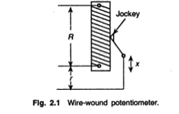
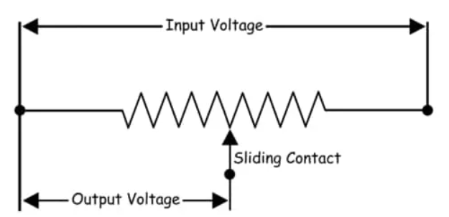
Precision wire-wound potentiometer
Precision wire-wound potentiometer which is used as a sensor.
A major advantage with this type is its large output.
Resolution and noise are important aspects to be discussed in connection with it

Slide 61
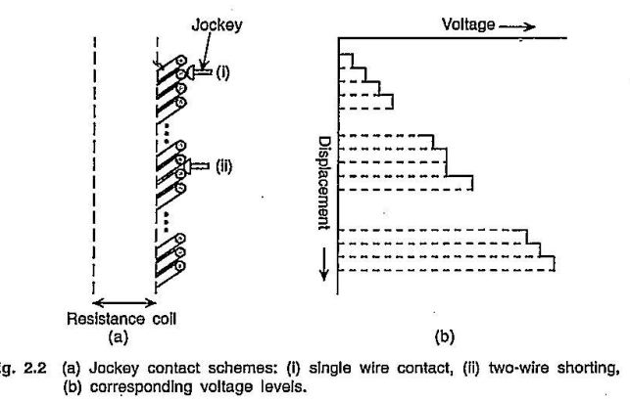
CROSS-SECTION OF THE N-TURN WINDING

Slide 62
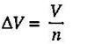
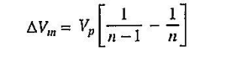
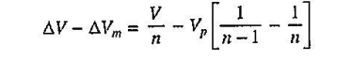
CROSS-SECTION OF THE N-TURN WINDING
2.2(a) with the wiper in two different possible positions:
(i) Touching only one wire
(ii)Touching two turns is important as is obvious.
In case (i) for a voltage supply V to the potentiometer, the voltage resolution would be
In Fig. 2.2(b), the solid line stairs show the output voltage steps each of which is equivalent to a value Vin.
But during transit, two adjacent wires are likely to be shorted as shown in Fig. 2.2(a) and a minor resolution pulse of magnitude is obtained, where pth and (p+1)th wires are shorted.
This shows that with increasing value of p, minor pulse magnitude also increases and the loss in resolution due to this shorting leads to an actual resolution value.

Slide 63
The jockey shape/profile or the ratio of jockey radius to wire radius and geometry of wire winding should be considered for reducing
If jockey radius is small, with the jockey in use for some time with pressure, the wire gets its round surface worn out to develop a flat surface and finally gets torn.
With a large radius of wire and close winding, this effect is small, but may short more than two wires during the movement of the jockey and hence, precision of measurement is affected.
For circular wire and circular jockey,
It is recommended that the ratio of their radii be around 10,
that is, rjockey/rwire approximately equal to 10.
Also, materials of resistance wire and jockey are equally important, particularly from the, wearing point of view and 'noise’.
For noise, among other things, the jockey construction is to be considered seriously.

Slide 64
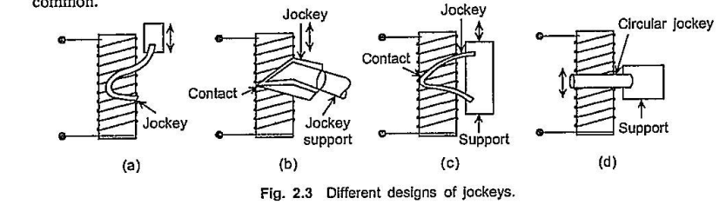
A few types of the jockeys
A few types of the jockeys are shown in Figs. 2.3(a), (b), (c), and (d).
The pressure at contact with the wire is provided by giving an adequate flexibility to the arm in relation to its mass.
However, the required pressure is dependent on the materials, jockey to wire radius ratio, and the proposed lifespan of the potentiometer. A value of 10-50 mN is quite common.

Slide 65
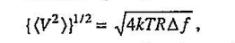
Noise is contributed by
1. Irregularities in resolution-a random type noise,
2. Thermal motions of molecules that come in equilibrium with random motions of electrons giving rise to white/Johnson noise with equivalent voltage output as
3.Contact non-uniformity mainly produced due to changing contact area and hence, contact resistance-aggravated by the presence of foreign particles in the area of contact (contact area changes with use, also contamination and oxidation change the resistance and hence, noise)
4.Rubbing action between the jockey and the wire-an equivalent of 100-300 µV is easily obtained with this rubbing action, and
5.Thermoelectric action specifically at high temperatures and DC operations.

Slide 66
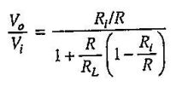
Sensitivity
Under ideal unloaded condition of the potentiometer is the output voltage per unit travel of the jockey.
Irregularities occur
(i) at the potentiometer ends and
(ii) due to power dissipation and corresponding rise in resistance of the potentiometer.
Adequate corrections are to be made for these.
A proper choice of the wire material with safety limit extended in current carrying capacity can minimize these errors to a certain extent.
The performance of the potentiometer changes in the loaded condition. Specifically, linearity is badly affected.
Considering the circuit of Fig. 2.4, if RL is the load resistance, Vi and Vo are input and output voltages respectively, R is the instantaneous tapped resistance across which Vo is obtained,
If the jockey begins movement from the bottom end, so that minimum Ri = 0 and maximum Ri = R.

Slide 67
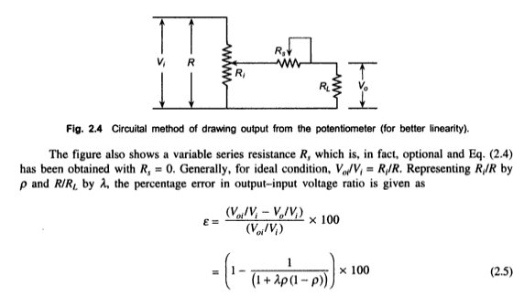
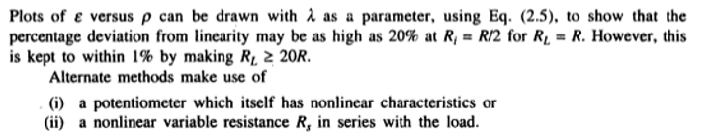

Slide 68
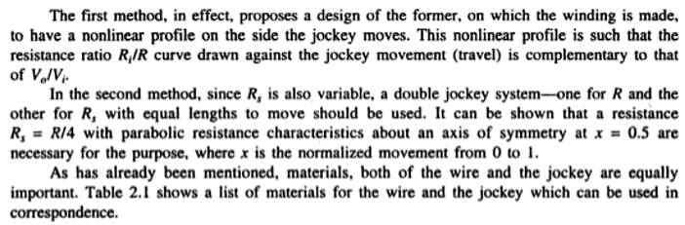
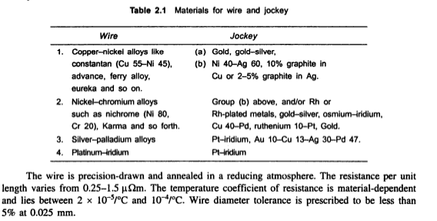

Slide 69
STRAIN GAUGE
In early mid- nineteenth century, the basic principle of strain gauge is change in resistance of a metallic wire in response to strain produced. But now the application is so vast, that it is difficult to prepare a gist of principle.
Strain gauges are of two types
1)Resistance type
2) Semiconductor type - more recent origin.
RESISTANCE TYPE:
Resistance strain gauges can be divided into two categories-
Unbonded
Bonded
The former, being of limited use has received less attention than the latter.

Slide 70
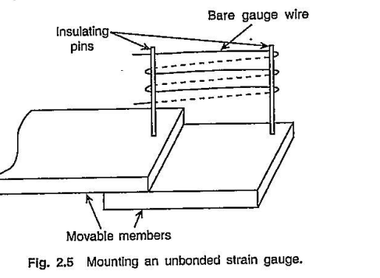
Unbonded strain gauge
Unbonded strain gauge consists of a piece of wire stretched in multiple folds between a pair or more of insulated pins fixed to movable- members of a 'body' or even a single flexible member whose strain is to be measured.
There occurs a relative motion between the two members on strain and the wire gets strained as well with a corresponding change in its resistance value. The scheme of such a system is shown in Fig. 2.5.

Slide 71
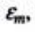
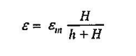
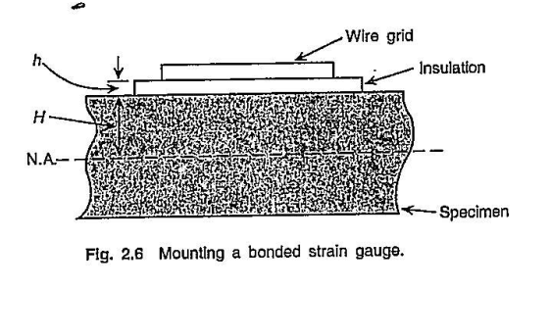
Bonded Type
The bonded type is more common and in its simplest form consists of wire/strip of resistance material arranged usually in the form of a grid for larger length and resistance value.
The grid is bonded to the test specimen with an insulation layer between the gauge material and the specimen as shown in Fig. 2.6.
If the insulation and the bonding material thickness is h which also is the height of the wire above the specimen surface and H is the distance of the neutral axis of the specimen from its surface, then the actual strain , in terms of measured strain is given by

Slide 72
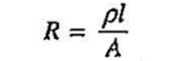
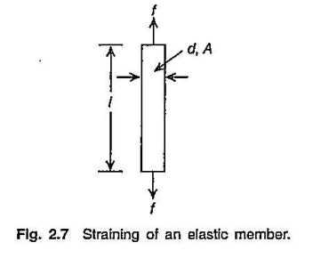
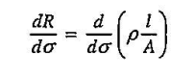
Classification of resistance gauges
Depending upon the implementation, the resistance gauges can be classified as:
(a) Unbonded metal wire
(b) Bonded metal wire
(c) Bonded metal foil
(d) Thin metal film by vacuum deposition
(e) Thin metal film by sputter deposition
Considering a circular cross-section metal resistance wire of length l and cross-sectional area A with resistivity ƥ of the material, the unstrained resistance of the wire is given by
If the wire is uniformly stressed along its length (Fig. 2.7) and if the stress is given by then

Slide 73
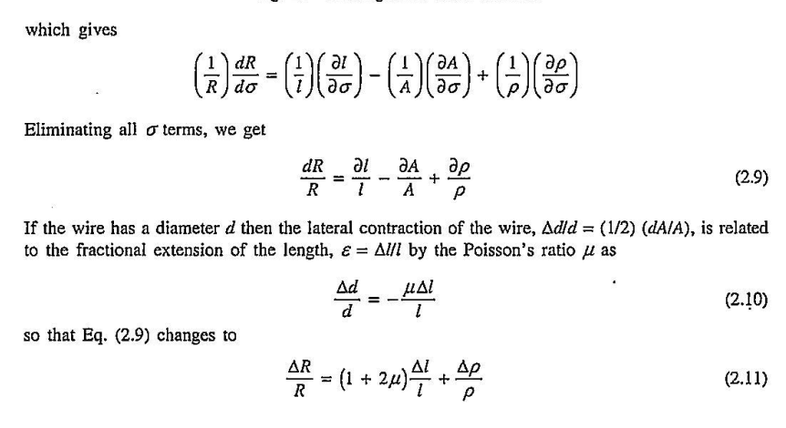
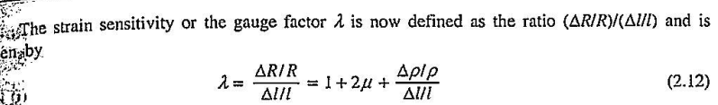

Slide 74


The last term on the right hand side of Eq. (2.12) is due to piezoresistance effect or Bridgeman effect and is often expressed as

Slide 75
Unbonded strain gauges are used in preloaded conditions not to allow the 'strings' to go slack. The wires are nickel alloys such as Cu-Ni, Cr-Ni, or Ni-Fe with gauge factor between 2 and 4 and diameters varying from 0.02-0.03 mm.
The bonded strain gauges are of a few types. When wire is used, the possibilities are
(i) Flat grid type,
(ii) Wrap around type, and
(iii) Woven type, although the flat grid type is more popular out of all the three.
Etched foil type resistance strain gauge is one variety that, in recent years, has most extensively been used.
A gauge consists of the resistance element of proper design/shape, the gauge backing, cement, connection leads, and often protective coating or other protective means.

Slide 76

Flat Grid Bonded Strain Gauge
The construction of the flat grid bonded strain gauge is shown in Fig. 2.9.
Such construction has the advantage of better strain transmission from the member to the wire grid, small hysteresis and creep, and is more accurate when the strain member is thin.

Slide 77

The foil gauges are etched out from deposited films or sheets and have higher surface area to cross-section ratio than wire gauges, and hence, have better heat transfer property so that they can handle higher current.
For wire gauges, the wires are usually drawn and often annealed, while bonded foil gauges consist of sensing elements which are formed from sheets of thickness less than 5 x 10⁻⁴ cm by photoetching processes so that any arbitrary shape can be given to these elements.
Because the wire grid in the grid type structure has a finite width, the gauge has a sensitivity to transverse strain which may be as large as 2% of the longitudinal sensitivity. In foil grid structure, the end turns can be made wider or fat enough so that the transverse strain sensitivity is lesser. A typical grid structure foil gauge is shown in Fig. 2.10.

Slide 78
Vacuum deposition and sputter deposition thin film gauges are produced where cement between the elastic element and the gauge is not necessary for bonding.
In the former case, a suitable elastic metal element which can be adapted for strain generation such as a diaphragm for pressure measurement, is placed in a vacuum chamber with a suitable dielectric material of much lower vapour point than the metal.
With application of requisite amount of heat, this dielectric material vapourizes and then condenses and finally forms a thin layer on the metallic member.
A template of a suitable shape is now placed over it and the evaporation-deposition process is repeated with the gauge material. Thus, the gauge is formed over the insulator substrate.

Slide 79
In the sputtering-deposition process,
The first step is nearly the same to form an insulating layer on the strain member.
In the second step, without using a template, the metallic gauge material is sputtered over the entire substrate and the gauge pattern is defined by using micro-imaging techniques and photosensitive masking materials from outside the chamber and finally sputter-etching is used to remove all unmasked layers inside the vacuum chamber.
One important aspect of resistance gauges is its temperature coefficient of resistance.
The temperature at which the strain is measured may be different from the temperature when the strain member is bonded.
This gives rise to a differential expansion between the strain member and the gauge resulting in error in strain measurement.

Slide 80


Slide 81



Slide 82


Slide 83


Slide 84


Slide 85


Slide 86
SEMICONDUCTOR STRAIN GAUGES
First lot of semiconductor strain gauges were produced early in mid-thirties from single crystal silicon or germanium by cutting thin strips.
It is still being done on the improvement of their performance and manufacturing ease because it has been known that although the semiconductor gauges have higher gauge factors, they are much inferior to the resistance types in so far as linearity and temperature stability are concerned.
The discovery of semiconductor strain gauges has cleared the path of smart sensors, including production of strain sensitive cantilevers and diaphragms by doping selected small areas of monolithic silicon slice. Semiconductor strain gauges can be divided into two classes:
(i) Bonded semiconductor
(ii) Diffused semiconductor depending on their implementation.
Strain sensitivity of semiconductor material depends, among other things, on the crystal material such as Si or Ge, doping levels (if any), type of doping materials, crystal cut-axis orientation, and so on.
The bandgaps of both intrinsic and extrinsic semiconductors are affected by temperature variations.
For intrinsic semiconductors, gauge factors are larger decreasing with increasing degrees of dopping, the thermal coefficients of resistivity also decreases.

Slide 87

The strain sensitivity of a semiconductor gauge is high and the large value is due to the large value of ΨE
,that is, specifically Ψ. The value of Poisson's ratio for semiconductors is less than that of metals although it is more in Si than Ge.
There are a number of piezoresistive coefficients in a semiconductor material, they are called 'fundamental’.
The longitudinal piezoresistive coefficients. in which the stress and current are in the same direction and the transverse piezoresistive coefficients, in which the stress and current are perpendicular to each other, are computed from these fundamental coefficients and the direction cosines of the current with respect to the crystallographic axes.

Slide 88

Practical aspect of using a semiconductor strain gauge is governed by ᵡ, R, gauge length, encapsulation/backing, bonding, leads geometry, and means of temperature compensation.
Size and shape of the gauge are equally important. Some possible and useful shapes are given in Figs. 2.12(a), (b). (c). and (d). Sizes are determined by the specimen size as also resistance value R.

Slide 89
Semiconductor gauges with/without backing are bonded to the specimen with epoxy-based adhesives, or for better, diffused semiconductor gauges arc attached to the specimen by semiconductor diffusion process.
The gauge is diffused directly on to the surface of the specimen such as a diaphragm, using photolithographic masking technique and an impurity such as boron is diffused into it.
No separate bonding is necessary here. In recent times, the specimen, that is the strained member such as a cantilever or a diaphragm itself is also made from Si and the whole unit is developed into a smart sensor.
A diaphragm of 2.5-25 mm diameter or cantilever of appropriate size is obtained in the main substrate of Si which is 50-750 mm in diameter.
The four arm bridge is developed on this diaphragm as also the circuit of measurement by diffusion process.

Slide 90


Slide 91

In fact, doping changes the gauge resistance as well, decreasing it with high doping level. Figure 2.14 shows the p-T characteristics with doping as a parameter.
Figure shows that higher doping gives high value of resistivity p and β the temperature coefficient of resistance—positive as well as high. But this occurs only up to a certain temperature above which the material behaves as in intrinsic conduction mode with negative temperature coefficient also of a very high value.
However, with heavy doping. p is moderate and β quite small, and this condition persists over a wider temperature range.

Slide 92

It has been discussed already, semiconductors under strain show piezoresistive effect which is so predominant over other effects related to Poisson's ratio and to on that based only on this dominant effect.
Pressure transducers have been produced and within the elastic limits of silicon, electrical output is found proportional to mechanical strain or stress. The scheme consists of a cantilever beam of silicon about 0.1mm thick on to both sides of which planar resistors are produced by diffusion.
Figure 2.15 shows the scheme with the header with connecting terminals. With the beam under stress, the resistors on the two sides of the beam undergo different changes because of compression on one side and extension on the other.
The difference is measured by a bridge. The length l can be inserted in a pressure all where a diaphragm actuated by the inlet pressure is so mounted and attached to the cantilever that the deformation of the diaphragm is transmitted to the cantilever and hence, to the diffused resistance gauges.

Slide 93


Slide 94
SESSION 9
RESISTIVE TRANSDUCER: RTD, MATERIALS USED IN RTD.
THERMISTOR: THERMISTOR MATERIAL, SHAPE.

Slide 95

RESISTIVE TRANSDUCER
A resistive transducer is an electronic device that is capable of measuring various physical quantities like temperature, pressure, vibration, force, etc.
The resistance of this transducer changes concerning the change in the physical quantities.
These transducers can function in both primary as well as in secondary mode but most of the time it is used as secondary.
The resistive transducers are of different types like resistive pressure transducers, thermistors resistors, LDR, etc.

Slide 96

Resistive Transducer (Contd.) Working
The working of a resistive transducer can be explained by considering a conductor rod as the transducer.
The transducer works on the principle of the length of the conductor.
The length of the conductor is directly proportional to its resistance and is inversely proportional to its cross-sectional area.
Here, if we consider the length of the conductor as L, the cross-sectional area as A, the resistance as R and the resistivity as ρ, then the resistance can be denoted as
$R={ρl}/A$
The resistance of the transducers can vary because of the change in environmental conditions as well as the physical properties of the conductor.
Measuring devices like AC or DC can be used to measure the change in resistance.

Slide 97

Resistive Transducer (Contd.) Resistive Transducer Circuit
The resistive transducer consists of a long conductor whose length can be varied with time.
One end of the conductor is connected while the other end is connected to a brush or a slider that can freely move along the length of the transducers.
We can calculate the distance of the object by connecting the object to the slider of the resistive transducer.
Whenever we apply energy to the object to displace it from its initial position, the slider will move along the length of the conductor as a result of which the length will change.

Slide 98
Resistive Transducer (Contd.) Advantages AND DISADVANTAGES
Advantages
The resistive transducer can be used to give very quick results.
The resistive transducers are available in various sizes and they have a considerably high amount of resistance.
We can use both AC or DC for calculating the change in resistance.
They are quite affordable and can be easily available in the market.
W can use this transducer in various applications even when they are not a necessity.
It can be used to give accurate results.
Disadvantages
A lot of power is wasted in moving the sliding contacts.
The sliding contacts can produce a lot of noise.

Slide 99
Resistive Transducer (Contd.) Applications
A resistive transducer is mainly used to measure the temperature in various kinds of applications. When there is a change in temperature, the temperature coefficient of the resistive transducer changes which can be used to determine the change in temperature.
The resistive transducer can function as a potentiometer where the resistance of the transducer can be varied by changing the length of the conductor.
A resistive transducer can be used in the calculation of the displacement. When we apply strain on the resistor, the resistance changes. This characteristic can be used in the measurement of displacement, force, and pressure.

Slide 100

Resistance Temperature Detector (RTD)
A Resistance Temperature Detector (also known as a Resistance Thermometer or RTD) is an electronic device used to determine the temperature by measuring the resistance of an electrical wire.
This wire is referred to as a temperature sensor.
The variation of resistance of the metal with the variation of the temperature is given as
$R_{t}=R_{o}\left[1+\left(t−t_{0}\right)+β{\left(t−t_{0}\right)}^{2}+… \right]$
Where, R_{t} and R₀ are the resistance values at tºC and t₀ºC temperatures. α and β are the constants depends on the metals.
This expression is for huge range of temperature. For small range of temperature, the expression can be,
$R_{t}=R_{o}\left[1+\left(t−t_{0}\right)\right]$

Slide 101
Resistance Temperature Detector (RTD) Construction
The construction is typically such that the wire is wound on a form (in a coil) on notched mica cross frame to achieve small size, improving the thermal conductivity to decrease the response time and a high rate of heat transfer is obtained.
In the industrial RTD’s, the coil is protected by a stainless steel sheath or a protective tube.
The physical strain is negligible as the wire expands and increase the length of wire with the temperature change.
If the strain on the wire is increasing, then the tension increases. Due to that, the resistance of the wire will change which is undesirable. So, we don’t want to change the resistance of wire by any other unwanted changes except the temperature changes.
Mica is placed in between the steel sheath and resistance wire for better electrical insulation.
Due less strain in resistance wire, it should be carefully wound over mica sheet.

Slide 102

Resistance Temperature Detector (RTD) Signal Conditioning
In RTD the change in resistance value is very small with respect to the temperature.
So, the RTD value is measured by using a bridge circuit.
By supplying the constant electric current to the bridge circuit and measuring the resulting voltage drop across the resistor, the RTD resistance can be calculated.
Temperature is determined by converting the RTD resistance value using a calibration expression.

Slide 103

Resistance Temperature Detector (RTD) Two wire rtd bridge
In two wires RTD Bridge, the dummy wire is absent.
The output taken from the remaining two ends as shown in fig
If wires A and B are matched properly in terms of length and cross section area, then their impedance effects will cancel because each wire is in opposite position.
In order to overcome that 3 wire RTD is introduced, which is done by adding a dummy wire

Slide 104

Resistance Temperature Detector (RTD) THREE wire rtd bridge
If wires A and B are matched properly in terms of length and cross section area, then their impedance effects will cancel because each wire is in opposite position.
So that, the dummy wire C acts as a sense lead to measure the voltage drop across the RTD resistance and it carries no current
In these circuits, the output voltage is directly proportional to the temperature. So, we need one calibration equation to find the temperature.

Slide 105
Resistance Temperature Detector (RTD) 4 Wire RTD Principle
The most accurate lead wire configuration is the “true” 4-wire configuration.
In a true 4- wire configuration, the resistance of the lead wires does not contribute to the resistance of the sensor.
4-wire construction is used primarily where close accuracy is required.
The true 4-wire measurement uses the current-potential method.
A current of known value (I+) is passed through the sensor along the “current” lead wires.
The voltage generated across the sensor is measured using the “potential” lead wires (Vsensor) and the sensor’s resistance is calculated by dividing the measured voltage by the Known current.

Slide 106


Resistance Temperature Detector (RTD) 4 Wire RTD Principle
The 4-wire circuit is a true 4-wire bridge, which works by using wires 1 & 4 to power the circuit and wires 2 & 3 to read. This true bridge method will compensate for any differences in lead wire resistances.
The resistance of the lead wires is not a factor because:
The value of the current is equal at any point in the circuit. It is independent of the resistance of the lead wire.
The input impedance of the voltage measurement circuitry is high enough to prevent any significant current flow in the voltage leads. Since no current is flowing, the voltage along the potential leads does not change along their length.

Slide 107
Resistance Temperature Detector (RTD) materials used in RTD
Platinum Resistance Temperature Detectors
Platinum RTDs are the most common type of RTD used in industrial applications.
This is because platinum has excellent corrosion resistance, excellent long-term stability, and measures a wide range of temperature, (-200…+850°C)
Nickel Resistance Temperature Detectors
Nickel RTDs are less expensive than platinum and have good corrosion resistance.
However, nickel ages more rapidly over time and loses accuracy at higher temperatures. Nickel is limited to a measurement range of -80…+260°C.
Copper Resistance Temperature Detectors
Copper RTDs have the best resistance to temperature linearity of the three RTD types, and copper is a low cost material.
However, copper oxidizes at higher temperatures. Copper is limited to a measurement range of -200…+260°C

Slide 108

Resistance Temperature Detector (RTD) materials used in RTD

Slide 109
Resistance Temperature Detector (RTD) ADVANTAGES AND DISADVANTAGES
Advantages:
Good sensitivity
Linear over wide operating range
Uses standard copper wire
High temperature operating range
Copper RTD’s minimise thermocouple effect
Interchangeability over wide range
Works in wide temperature ranges
Disadvantages:
Bulky in size and fragile
Slow thermal response time due to bulk
Self-heating problems
More susceptible to electrical noise
More expensive to test and diagnose

Slide 110

Thermistor
The ‘Thermistor’ uses resistance to detect temperature.
Thermistors can measure temperatures across the range of -40 ~ 150 ±0.35 °C (-40 ~ 302 ±0.63 °F).
Typical operation resistances are in the kW range, although the actual resistance may range from few W to several MW.
The adjoining figure shows typical types of thermistors.
The shape of the thermistor probe can take the form of a bead, washer, disk, or rod.
Basically, thermistors are broadly classified as Ceramic, PTC (positive temperature coefficient) and NTC (negative temperature coefficient) thermistors.

Slide 111
Thermistor Basic Working Principle
The electrical resistance of metals depends on temperature.
By measuring the changing resistance, the temperature can be determined.
The change in resistance can easily be converted to an electrical signal transmittable.
A thermistor is made of semiconductor, a mixture of metal oxide.
Metals usually have a positive resistance coefficient with respect to temperature.
Unlike metals, the semiconductors have a negative resistance coefficient.
This is the main difference between a thermometer and a thermistor.
Thus, it can be said that a PTC Thermistor is similar to an Resistance Temperature Detectors (RTD).

Slide 112
Thermistor Basic Working Principle (Contd.)
Thus, thermistors are based on the principle of when the temperature of the resistors changes, the electrical resistance of the resistors will change correspondingly.
In Negative Temperature Coefficient (NTC) thermistors, when the temperature of the resistors increases, the resistance of the resistors will be decreased.
In Positive Temperature Coefficient (PTC) thermistors, when the temperature of the resistors increases, the resistance of the resistors will also be increased.

Slide 113


Thermistor Basic Working Principle - PTC
The PTC (Positive Temperature Coefficient) is a temperature sensitive semiconductor, which is made of doped polycrystalline ceramic on the basis of barium titanate.
The resistance of these thermistors increases sharply when a defined temperature is reached.
This property is the reason for the self-regulation characteristic, which the PTC heating elements make use of.
Due to the special Resistance-Temperature-characteristic, there is no additional temperature regulation or safety device necessary while reaching high heat-power level when using the low resistance area.
The PTC-heating element regulates the power sensitively according to the required temperature. The power input depends on the requested heat output

Slide 114


Thermistor Basic Working Principle - NTC
The NTC thermistors which are discussed herein are composed of metal oxides.
The most commonly used oxides are those of manganese, nickel, cobalt, iron, copper and titanium.
As seen from the adjoining figures, the resistance of these thermistors decreases with the increase in temperature.
In the basic process of fabrication, a mixture of two or more metal oxide powders are combined with suitable binders, formed to a desired geometry, dried, and sintered at an elevated temperature.
By varying the types of oxides used, their relative proportions, the sintering atmosphere, and the sintering temperature, a wide range of resistivities and temperature coefficient characteristics can be obtained.

Slide 115
Thermistor Application
The thermistor is a versatile component that can be used in a wide variety of applications where the measurand is temperature dependent.
Depending on the type of application and the specific out put requirements, the PTC or the NTC Thermistor is used.
Thus, the application have to be broadly divided as PTC Thermistor applications and NTC Thermistor applications respectively.
Following are the various applications.

Slide 116
Thermistor Application - PTC
Over-current protection.
Telecommunication applications.
Picture tube degaussing.
time delay and switching applications.
motor starting.
heating elements.
‘Fuse’ for Short-circuit and over-current protection.
‘switch’ for Motor start Degaussing.
‘temperature sensor’ in measurement and control & over temperature protection circuits.
They are used to limit temperature for motor protection and over temperature protection circuits.
They are also used as ‘level sensors’ and ‘limit indicators’.

Slide 117
Thermistor Application - NTC
NTC thermistors are used in General Industrial Applications such as Industrial process controls, Photographic processing, Copy machines, Soldering irons (controlled), Solar energy equipment, etc
They are used in Consumer / Household Appliances like Thermostats, Burglar alarm detectors, Refrigeration and air conditioning, Fire detection, etc
They are used in Medical Applications like Fever thermometers, Dialysis equipment, Rectal temperature monitoring, Respiration rate measurement, Blood analysis equipment, Respirators, etc.
They are used in Instrumentation Applications like Motor winding compensation, Infrared sensing compensation, Instrument winding compensation, etc.
They are used in Automotive and Transportation Applications for Emission controls, Differential temperature controls, Engine temperatures, Aircraft temperatures, Rotor/bearing temperatures, etc

Slide 118
Thermistor Application - NTC
They are used in High Reliability Applications for monitoring Missiles & spacecraft temperatures, Aircraft temperature, Submarines & underwater monitoring and as a Fire control equipment.
They are used in Communications Applications for Transistor temperature compensation, Gain stabilization, Piezoelectric temperature compensation.
Apart from all these, they are also used in RF / Microwave power measurement, Voltage regulation circuits, Time delay devices, Sequential switching, Surge suppression, Inrush current limiting, etc.
They are used in Food Handling Applications like Fast food processing, Perishable shipping, Oven temperature control, Coffee makers, Freezing point studies.

Slide 119
Thermistor Advantages
High accuracy, ~±0.02 °C (±0.36°F), better than RTDs, much better than thermocouples.
High sensitivity, ~10 times better than RTDs, much better than thermocouples. As a result, lead wire and self-heating errors are negligible.
Small in size compared to thermocouples.
Response time shorter than RTDs, about the same as thermocouples.
Reasonable long term stability and repeatability.

Slide 120
Thermistor Limitations
Limited temperature range, typically -100 ~ 150 °C (-148 ~ 302 °F).
Nonlinear resistance-temperature relationship, unlike RTDs which have a very linear relationship.
They can be affected by self-heating errors that result from excitation current being dissipated in the thermistor.
Thermistors are also relatively fragile, so they must be handled and mounted carefully to avoid damage.
Exposure to higher temperatures can de-calibrate a thermistor permanently, producing measurement inaccuracies.

Slide 121

Thermistor SHAPES

